Slide 1


Final Project Presentation
Comp-3710:- Artificial Intelligence Concept
Designed and Created by:-
Aksh Patel
Nihar Patel
Yash Goswami
Nishrut Patel

Slide 2


Topic
Forest fire

Slide 3
Why this topic ?
From the stats, the second biggest concern of 2020 for each species was Forest fire. So, we decided to simulate the environment in such circumstances.
Link to source

Slide 4

Content:
Introduction
Key Points
Facts
Tools & Techniques
Conceptual Data
How it works ?
Conclusion
Future Improvements

Slide 5
Introduction:
Nowadays, because of global warming we cannot estimate weather patterns. So our model considers a new element in forest Track of forest fire and its effecting, namely the dynamics of a forest animal, intimately linked to the trees. Our model shows that how the animals and trees react when there is increase in the fire and temperature.

Slide 6

Key Points: ➔The fire spread in all four direction: North, East, South and West. ➔The model assumes there is no wind. So, the fire must have trees along its path in order to advance. ➔Fire can be manually done by clicking the lightning button.

Slide 7

Facts:
Animal die by:
Loosing Energy
Fire Burns.
Trees Die by:
Fire Burns.
Fires are initiated:
Random location.
By clicking the lightning Button.
Fires kill:
Trees.
Animals.
Fires die if:
There are no more live trees to burn in the adjacent neighborhood.

Slide 8


Tools and Techniques
Net logo
This is the only tool that we have used in our entire project, as it was very easy and convenient platform to run and execute the simulation.

Slide 9

Conceptual Data We have developed a Net Logo Model which depicts the information of dead species, % of forest burned down, temperature of forest thorough out the forest fire and graphs :
Dead rabbits
Dead cows
Percent burned
Current temperature
Maximum temperature
Average temperature
Different type of graphs such as trees, number of cows and rabbits alive and mean energy of them.

Slide 10
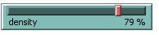

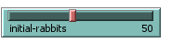
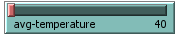
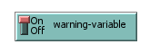
How it works
We have several options given to the users to adjust the environment as per their requirements.
They can adjust the density of the forest population of the species (in our model we have two of them), and average temperature of the forest.

Slide 11
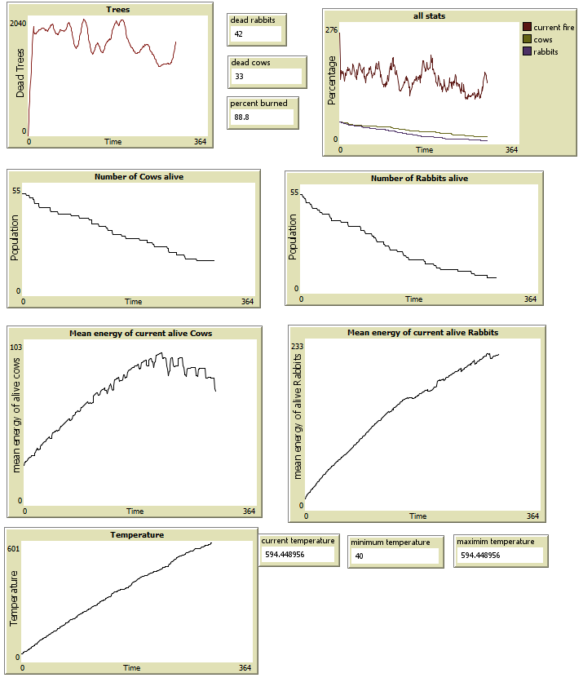
Reporting Statistics
We have plotted the graph, so we can easily predict the fire’s behavior in the environment as per the user’s input data. Moreover, we can also see the number of animals alive, affected; current, minimum and maximum temperature.

Slide 12
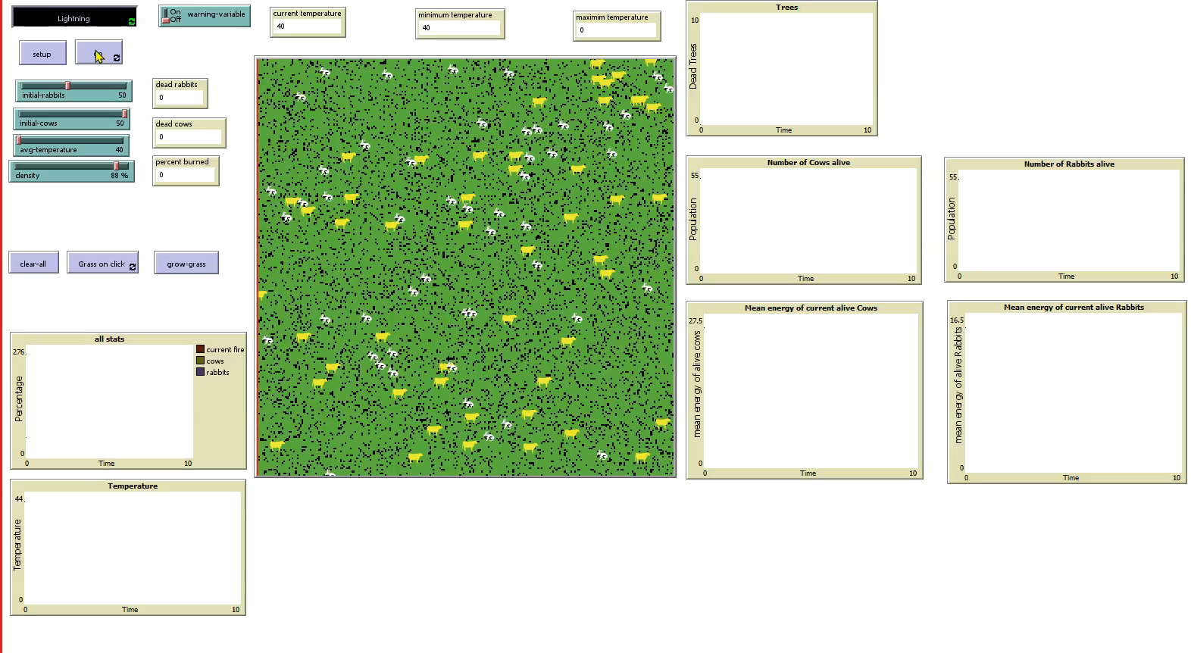
Basic Simulation
We are demonstrating this simulation in a dense forest; thus, the fire reaches to the other end of the forest burning down 91% of forest and 70% of the species.

Slide 13
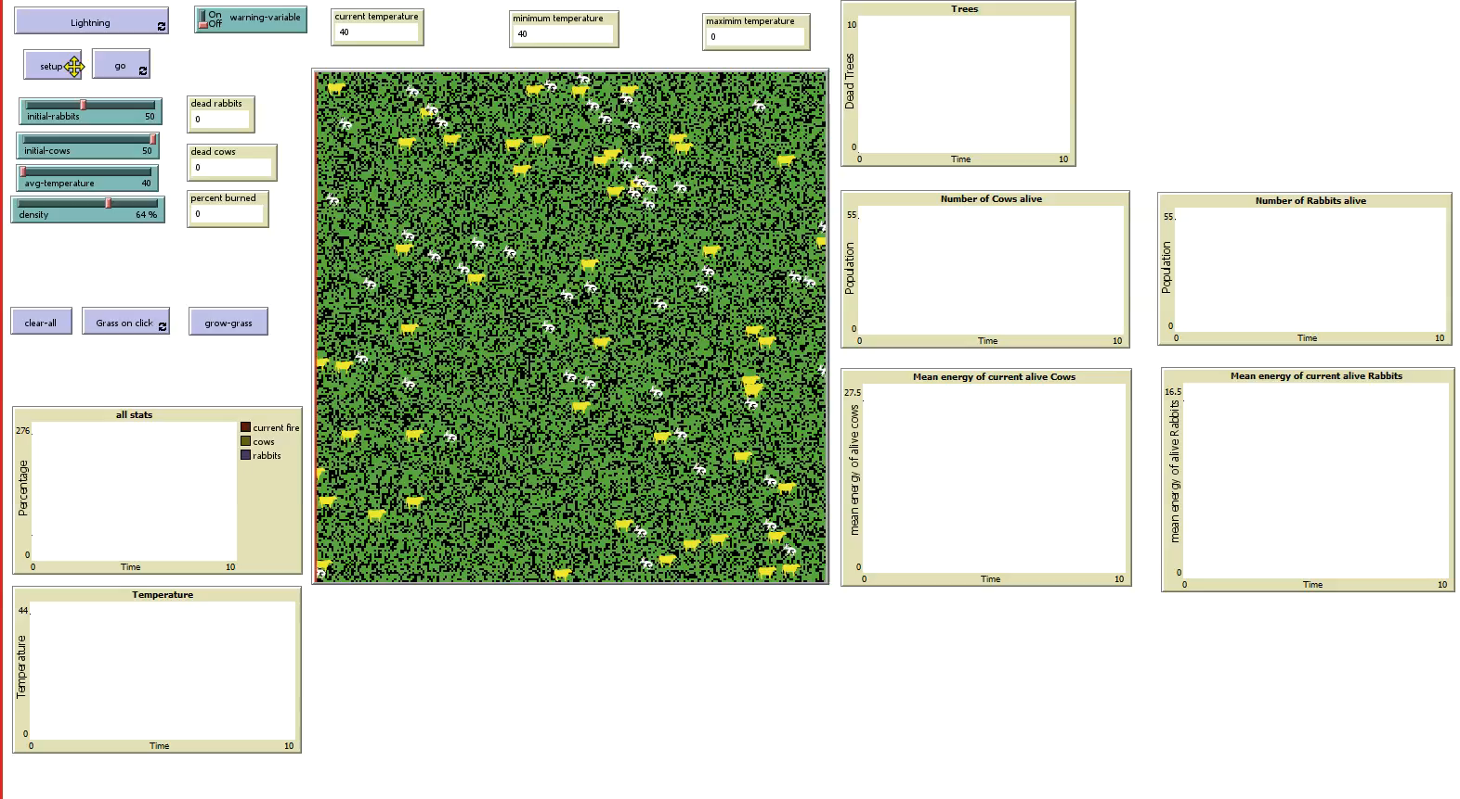
Simulation for lightening
This is a simulation in the less dense forest where we can demonstrate the example of the lightening igniting the forest.

Slide 14
Conclusion
From this model, we can estimate the existing number of the animals, density of the forest , maximum temperature during forest fire.
When a fire escapes initial attack, the reinforcement forces include an overhead suppression team who will carefully assess the overall fire situation. The purpose of the prediction process, therefore, is to enable this team to estimate what a fire will do under the expected conditions.

Slide 15

Future Improvements
Add more animals and thus making it more realistic.
Track the exact locations of animals through satellite, however this is not possible in dense forest.
For above listed improvements we need better algorithm such as approximate counting algorithms for predictions of huge numbers.

Slide 16

Thank you for watching. ☺

